Slide 1
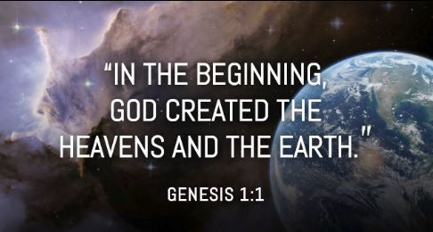
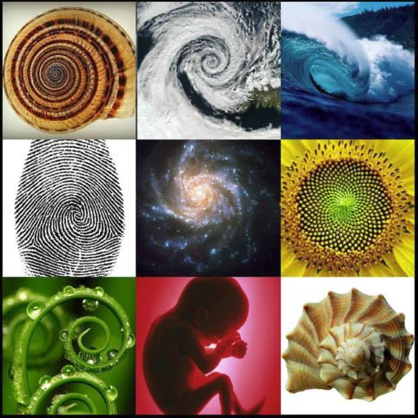
The Known Universe – American Museum of Natural History

Slide 2
7 Life Lessons
“Awakening the spark of SPIRIT that endures for a LIFE time ☺”
Group Learning 1

Slide 3
Sunday Gospel Give to Caesar and God
Narrator
Pharisees
Followers of Herod
Jesus
Matt Kelly - Rebel Video

Slide 4
Life Lesson 1 3 Ways to connect to the SPIRIT
Brain
Education is NOT Transformation Too much education limits our capacity for awakening/transformation
Pray
Silence
Music
Nature
Do
Jesus message was one of action and prayer We learn best when we ‘experience’ our actions as opposed to reflecting on our prayer.

Slide 5
Life Lesson 1 3 Ways to connect to the SPIRIT
Do
Jesus message was one of action and prayer We learn best when we ‘experience’ our actions as opposed to reflecting on our prayer.
Pray
Silence
Music
Nature - Video
Brain
Education is NOT Transformation Too much education limits our capacity for awakening/transformation

Slide 8
Life Lesson 1 Faith Sharing Cards
“I helped my father get down the steps, to go on the field” -Zach
“I helped my friend with basketball” –Patrick
“I taught this kid on my basketball team about a new play, we learned.” –Tony
“I helped my friend when she had family issues.” –Meghan
“I helped open a friend’s locker” –
“I helped my friend catch up in my literacy class” –John
“I helped my friend’s little brother feel welcome” –Katie
“I went to the mall with my friend and she didn’t have enough money yet, so I bought her the shoes she wanted” –Becca
“I gave all my teachers chocolate bars for Valentine’s Day” –Fred
“Helped my friend pick up his books” – John
“I have a player on my basketball team a tip on how to play defense. It’s his first year playing” – Tony
“I saw a little autistic girl in church who smiled at me and she came over at the end of mass and started talking to me, so I talked to her a little while after mass” –Becca
“I lent money to my friend to get food” – Fred
“Some kid got hit in the face with a hockey puck, so I got a band-aid” –Zach
“I helped my friend research the abacus for REACH” –Katie
“I did my sister’s chores for her” – Vittoria
“I got back my friend’s speaker from a kid that stole it from him on the bus” -Danny

Slide 9
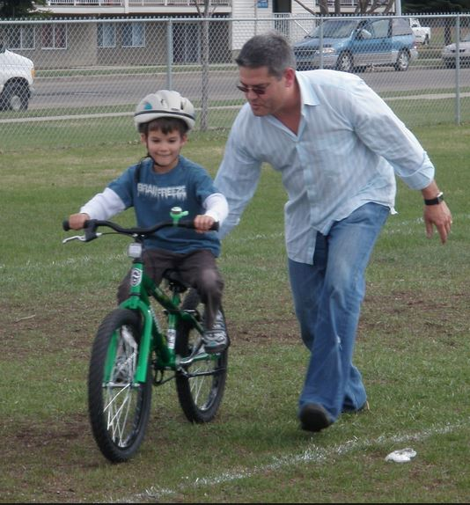
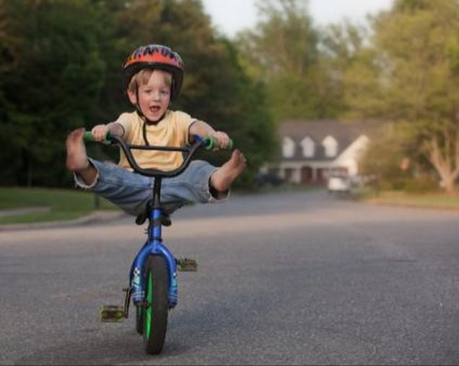
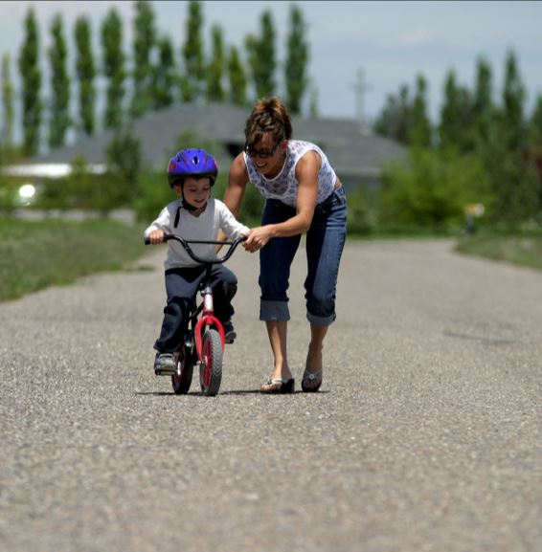
How is Religion like riding a bike ?
Once you learn/know…
You never forget ☺

Slide 10
Good Social Justice Project Site ‘dosomething.org’

Slide 11
The new addiction ☹ “The quieter you become … the more you can hear”

Slide 12
Life Lesson 2 Life Journey
6 Levels of Human Life
0 – Heart/LOVE – Everyone, Everyone, Everyone starts with God’s Grace; your Original Blessing ☺ 5 Brain Surges – @ ages 1, 4, 7, 11, 15 – 18
1 - Information
2 – Knowledge ( I BELIEVE )
3 – Intelligence
-----------------------------------------------------------
4 – Understanding/Awakening – Candidates GOAL
5 – Wisdom ( I KNOW )
6 - Transformation

Slide 13
What makes you a better person ?

Slide 14
How is this game connected to religion?

Slide 15
There's nothing you can do that can't be done Nothing you can sing that can't be sung Nothing you can say but you can learn how to play the game It's easy
There's nothing you can make that can't be made No one you can save that can't be saved Nothing you can do but you can learn to be you in time It's easy
All you need is love x 3 Love is all you need
(Love, love, love) x 3
All you need is love x 3 Love is all you need
There's nothing you can know that isn't known Nothing you can see that isn't shown There's nowhere you can be that isn't where you're meant to be It's easy
All you need is love x 3 Love is all you need
All you need is love, all together now All you need is love, everybody All you need is love, love Love is all you need
Love is all you need x 3

Slide 16
Group Learning 1 Music
All You Need is Love – Beatles
All You Need is Love – One Direction
Open the Eyes of My Heart Lord – Christoper Duffley
The Church needs YOU – Matt Kelly

Slide 17
